Slide 1
Turbocharged Insights: AI-Driven Maintenance for NASA Jet Engines
PREDICTIVE MAINTENANCE OF NASA TURBOFAN JET ENGINES
-
A PROGRESS REPORT
by:
Aksa Ann Saji
Habib Mohamed
Mojan Kaviyanipour
Venkata Surya Vadarevu
Vignesh Prabhu Alagirisamy

Slide 2
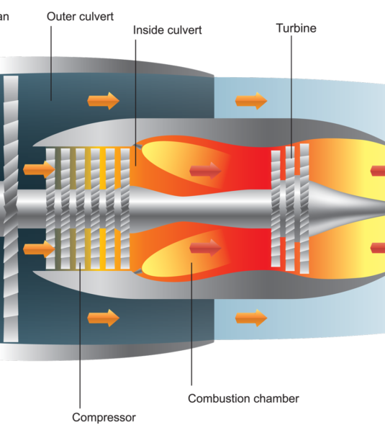
CONTENTS
Introduction and Objective
Dataset overview
Coding process model
Possible problems to solve
Graphical insights
Progress - hyperparameter selection for model training
Progress – model estimations
Engine Health Classification Prediction
Further progress for the project
Conclusion

Slide 3
INTRODUCTION AND OBJECTIVE
Introduction:
Prognostics and health management is an important topic in the aviation industry for predicting state of assets to avoid downtime and failure. Each engine starts with different degrees of initial wear and manufacturing variation which is unknown to the user. This wear and variation is considered normal, i.e., it is not considered a fault condition. There are three operational settings that have a substantial effect on engine performance: compressor pressure ratio, turbine inlet temperature and specific thrust and fuel consumption.
The engine is operating normally at the start of each time series, and develops a fault at some point during the series. In the training set, the fault grows in magnitude until system failure. In the test set, the time series ends some time prior to system failure.
Objective:
To develop a machine learning framework to predict the number of remaining operational cycles before failure in the test set, i.e., the number of operational cycles after the last cycle that the engine will continue to operate. Also to provide a vector of true Remaining Useful Life (RUL) values for the test data based on historical performance data.
This enables proactive maintenance strategies, ensuring optimal aircraft reliability and performance by making sure that none of the aircrafts need to put up with malfunctioning or faulty components causing delays in expected project deadlines.
Additionally, we have included a new classification called engine health, which helps improve the accuracy of predictions by assessing the overall condition of the engine and identifying patterns that may indicate impending failures.

Slide 4

DATASET OVERVIEW:
Data Acquisition: Utilizing NASA’s C-MAPSS dataset, which provides comprehensive information on aircraft engine performance.
Dataset: Batch FD001- 13,000 rows
Train Trajectories: 100
Test Trajectories: 100
Conditions: One (Sea Level)
Fault Modes: One (HPC Degradation)

Slide 5
DATASET OVERVIEW (CONTD.)
Values | Values
'Unit', | "(Physical core speed) (rpm)",
'cycle', | "(Engine pressure ratio(P50/P2)",
'op_setting_1', | "(HPC outlet Static pressure) (psia)",
'op_setting_2', | "(Ratio of fuel flow to Ps30) (pps/psia)",
'op_setting_3 | "(Corrected fan speed) (rpm)",
"(Fan inlet temperature) (◦R)", | "(Corrected core speed) (rpm)",
"(LPC outlet temperature) (◦R)", | "(Bypass Ratio) ",
"(HPC outlet temperature) (◦R)", | "(Burner fuel-air ratio)",
"(LPT outlet temperature) (◦R)", | "(Bleed Enthalpy)",
"(Fan inlet Pressure) (psia)", | "(Required fan speed)","
"(bypass-duct pressure) (psia)" | "(Required fan conversion speed)",
"(HPC outlet pressure) (psia)", | "(High-pressure turbines Cool air flow)",
"(Physical fan speed) (rpm)", | "(Low-pressure turbines Cool air flow)
The Dataset Contains a Total of 26 Columns with readings for these Values
A variable called "RUL" is created as the target variable which will be tested against the following predictors:

Slide 6
CODING PROCESS MODEL:
Feature Engineering: Extract relevant features from raw data, including sensor readings, operating conditions, and maintenance history.
Model Selection and Training: There were 2 Main Approaches adopted For This Model
Static Data Model: where we Experiment with various regression and classification models (e.g., Linear Regression, Decision Tree, Random Forest, SVM, XGBoost) to identify the most effective approach for predicting RUL and we assumed that the dataset will not change over time.
Dynamic Data model: where we made dynamic RLU predictions to predict RUL at each time step , looking for degradation pattern , capture long term dependency , anomaly detection , continuous monitoring where we considered the whole dataframe (historical data) that is updated in a timely manner and treated it as time series problem and solve with RNN , LSTM , GRU models.
Model Evaluation: Assess model performance using metrics like accuracy and Mean Absolute Error to select the best-performing model.

Slide 7
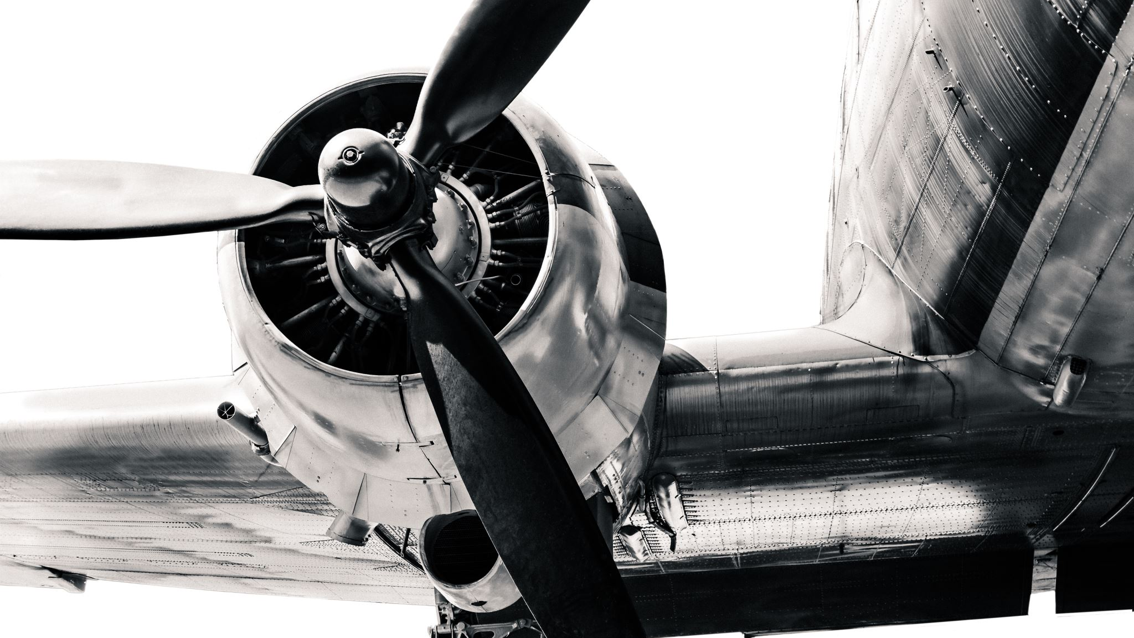
POSSIBLE PROBLEMS TO SOLVE:
Accurate RUL Predictions: Enhance the precision of RUL predictions to improve maintenance scheduling.
Proactive Maintenance: Enable timely interventions to prevent unexpected failures.
Optimized Performance: Ensure continuous and optimal performance of aircraft engines.
Cost Reduction: Minimize maintenance costs by avoiding unnecessary repairs and downtime.
Check the Status of health of the Engine based on RUL

Slide 8
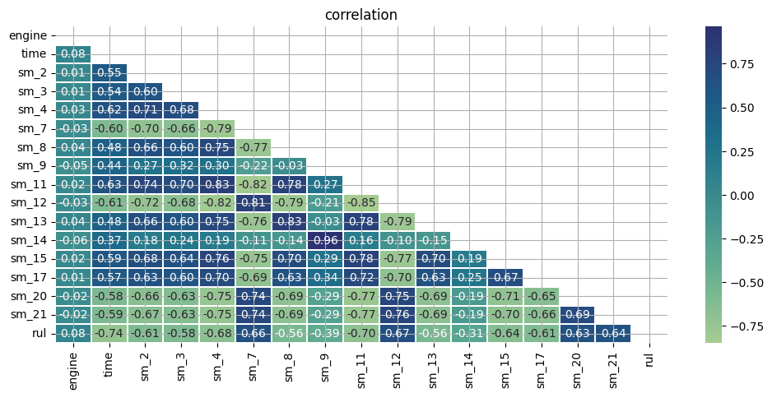
GRAPHICAL INSIGHTS - CORRELATION HEATMAP
RUL has good correlation with sensor measurements.
Top Features for RUL: time and sm_11 have the strongest negative correlation with RUL.
sm_11: HPC outlet Static pressure
Top Features for RUL: sm_7 and sm_12 have the strongest positive correlation with RUL.
sm_7 : HPC outlet pressure
sm_12: Ratio of fuel flow to Ps30

Slide 9
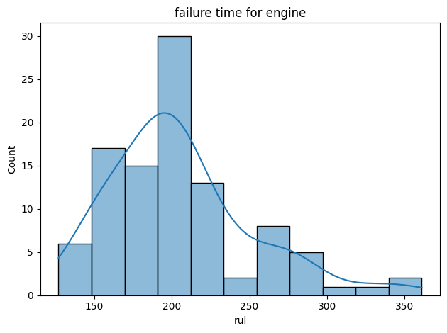
GRAPHICAL INSIGHTS - AVERAGE RUL FOR THE ENGINES
It's shown that the engine starts to fail when it reaches number count (y-axis) above 20 and the RUL range (x-axis) is around 200.

Slide 10

PROGRESS - HYPERPARAMETER SELECTION FOR MODEL TRAINING:
Model | Hyperparameters
Linear Regression | No Parameters
Decision Tree | Best parameters: {'max_depth': 10, 'min_samples_leaf': 4, 'min_samples_split': 10}
Random Forest | Best parameters: {'max_depth': 10, 'min_samples_split': 2, 'n_estimators': 200}
SVM | Best parameters: {'C': 10, 'gamma': 'scale', 'kernel': 'rbf'}
XGBoost | Best parameters: {'learning_rate': 0.1, 'max_depth': 5, 'n_estimators': 50}

Slide 11
PROGRESS – MODEL EVALUATION METRICS:
Estimations for static models:
 | MAE | MSE | RMSE | R2
Linear Regression | 34.02 | 1972.23 | 44.41 | 0.57
Random Forest | 30.15 | 1760.18 | 41.95 | 0.62
Decision Tree | 42.03 | 3578.68 | 59.82 | 0.22
XGBoost | 31.27 | 1897.27 | 43.56 | 0.59
SVR | 30.09 | 1817.51 | 42.63 | 0.60

Slide 12
PROGRESS – MODEL EVALUATIONS (CONTD.)
Estimations for Dynamic Models:
 | MAE | MSE | RMSE | R2
LSTM | 30.83 | 1782.81 | 42.22 | 0.61
GRU | 30.10 | 1735.03 | 41.65 | 0.62

Slide 13
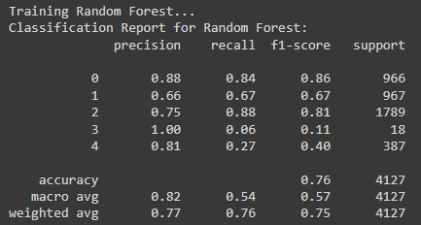
ENGINE HEALTH CLASSIFICATION PREDICTIONS
The classification system for engine health enhances prediction accuracy by evaluating the engine's overall condition and detecting patterns that could signal potential failures. This proactive assessment helps in identifying issues before they escalate, leading to more reliable performance insights.
Precision: Indicates the proportion of true positive predictions out of all positive predictions made by the model. For example, precision for class 0 is 0.88, meaning 88% of the predicted class 0 instances were correct.
Recall: The proportion of true positive predictions out of all actual positive instances. For class 2, the recall is 0.88, meaning the model correctly identified 88% of all actual class 2 instances.
F1-Score: The harmonic mean of precision and recall, providing a balance between the two. For class 1, the F1-score is 0.67.
Support: The number of actual occurrences of each class in the test set. Class 2 has the highest support (1789 instances).
Overall Accuracy: The model achieved an accuracy of 0.76 across all classes.

Slide 14
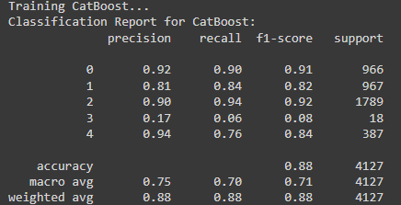
ENGINE HEALTH CLASSIFICATION PREDICTIONS (CONTD.)
The metrics are generally better than those for Random Forest. For example, the precision for class 2 is 0.90, and recall is 0.94.
Accuracy: The model performed better overall with an accuracy of 0.88, indicating it made correct predictions more often than Random Forest.
The performance metrics indicate that CatBoost is particularly strong for classes 0, 2, and 4.

Slide 15
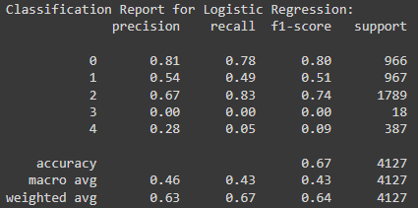
ENGINE HEALTH CLASSIFICATION PREDICTIONS (CONTD.)
The model shows several warnings, particularly a ConvergenceWarning, indicating that it didn’t fully converge, likely due to the number of iterations being insufficient. This could lead to suboptimal performance.
Several UndefinedMetricWarnings indicate that the model failed to predict certain classes (specifically 3), leading to a precision of 0.00 for those classes.
Accuracy is the lowest among the three models at 0.67. The model struggles with classifying certain labels, as shown by the poor F1-scores for classes 3 and 4.

Slide 16
ENGINE HEALTH CLASSIFICATION PREDICTIONS (CONTD.)
CAT Boost is the best-performing model, achieving the highest accuracy and balanced metrics across classes.
Random Forest performs reasonably well but not as effectively as CAT Boost, particularly in precision and recall for specific classes.
Logistic Regression shows signs of underperformance, especially with certain classes, likely due to convergence issues and class imbalance.
Best Model Identification
After evaluating all models, CAT Boost is identified as the best model based on accuracy, and Recall with the following performance metrics:
Accuracy: 0.8835
Precision: 0.8828
Recall: 0.8835
F1-Score: 0.8818

Slide 17
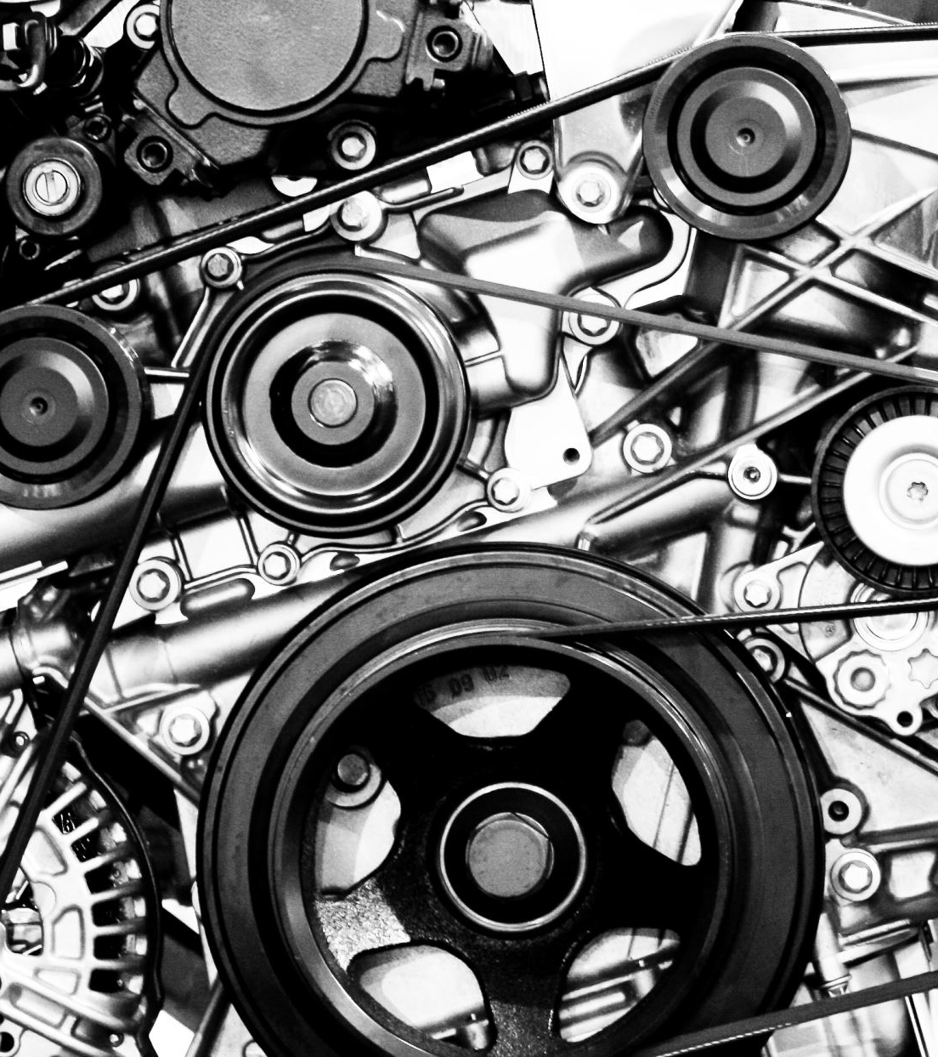
IDEAS FOR FURTHER PROGRESS OF THE PROJECT:
Make predictions from each of these models to determine the RUL of each of the engine components so we can reach the set target goals.
Create time series graphs to show forecasts of the possibilities of the engine parts malfunctioning or failing.
Fine tune the code through changing hyper parameters for better results and more accurate RUL prediction
Make it a real time monitoring tools by connecting it to dynamic databases.
More Precise Ranges could be calculated in real time to predict the Status of the Engine’s Health

Slide 18
CONCLUSION:
The problem was approached in the aspects of static and dynamic models to check the individual estimations such as MSE, MAE etc to get an idea of the overall performance of the prediction models.
Further steps of predicting the remaining useful life (RUL) of aircraft components need to be worked further upon to determine the solutions for the issues that are being tackled in this project.

Slide 19

THANK YOU
QUESTIONS?

